Slide 1


Human Activity Recognition
Team 30
Kesavaraj 2022701008
Rohan Nain 2020102023
Bonala Poorvaja 2020101096
Vivek 2022701001

Slide 2

Results
Observations
Recap
Models

Slide 3
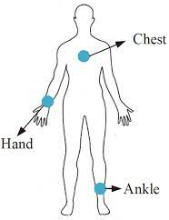


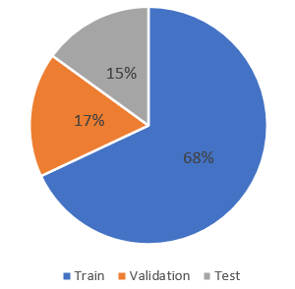
Recap
Attributes : 52
Recordings : 28L
Activities : 24
8 males
1 female
Attributes : 52
Recordings : 19L
Activities : 12

Slide 4

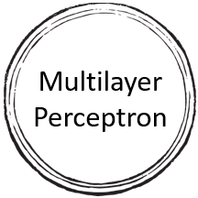

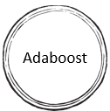

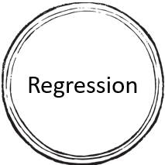


Models
Decision Tree

Slide 5
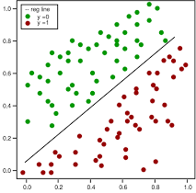
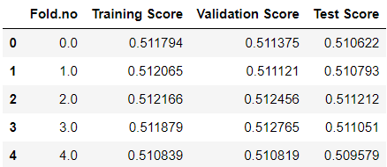
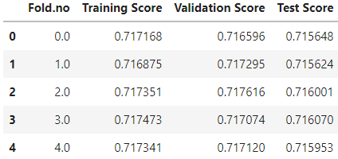
Regression
Attributes : 20
Recordings : 19L
Activities : 12
Train
Attributes : 52
Recordings : 19L
Activities : 12
Validation
Test
Model

Slide 6
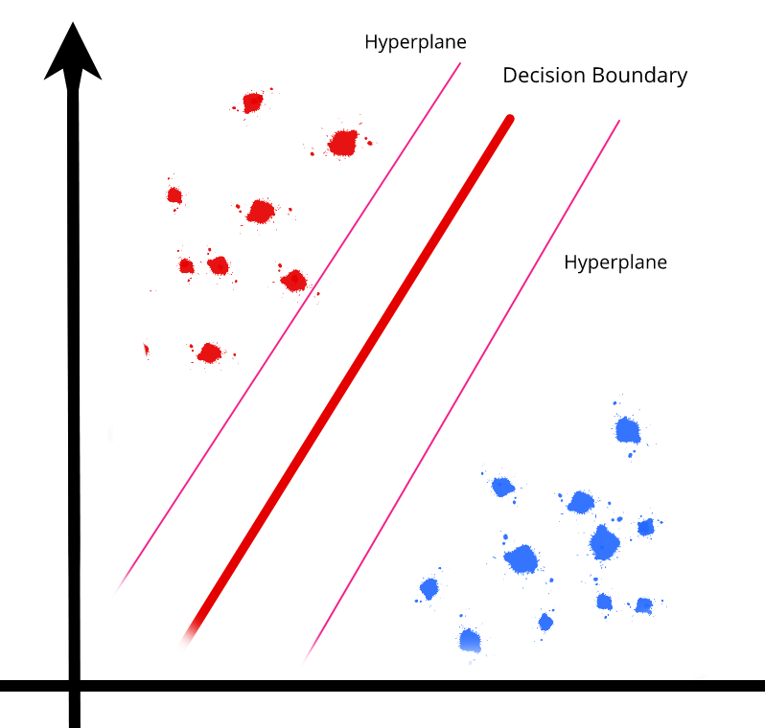
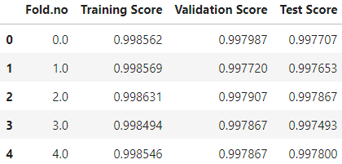
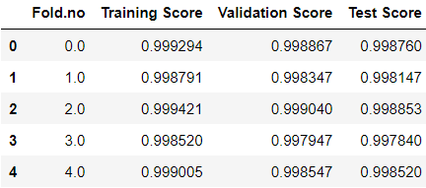
Support Vector Machine
Attributes : 52
Recordings : 6.5L
Activities : 12
Train
Attributes : 20
Recordings : 6.5L
Activities : 12
Validation
Test
Model

Slide 7
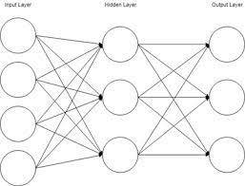
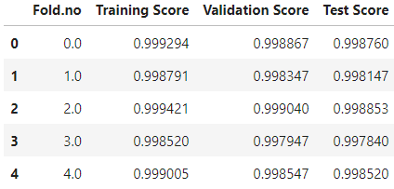
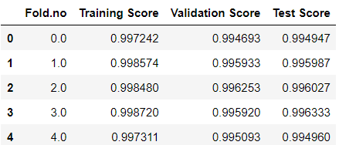
Multi Layer Perceptron
Attributes : 20
Recordings : 6.5L
Activities : 12
Attributes : 52
Recordings : 6.5L
Activities : 12
Train
Validation
Test
Model

Slide 8
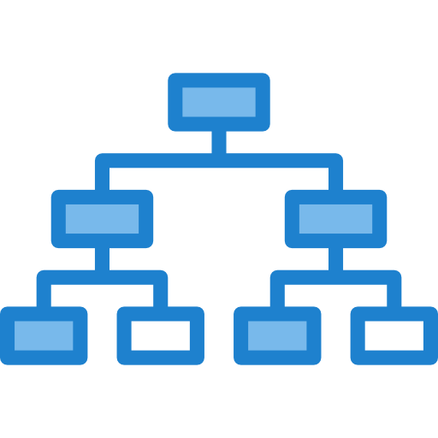
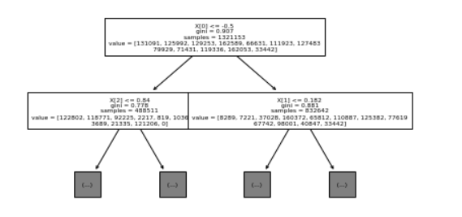
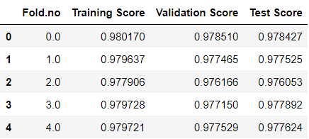
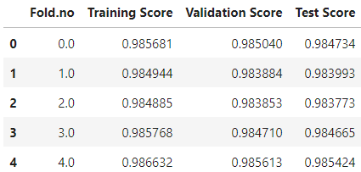
Original Decision Tree
Attributes : 52
Recordings : 19L
Activities : 12
Train
Attributes : 20
Recordings : 19L
Activities : 12
Validation
Test
Model

Slide 9
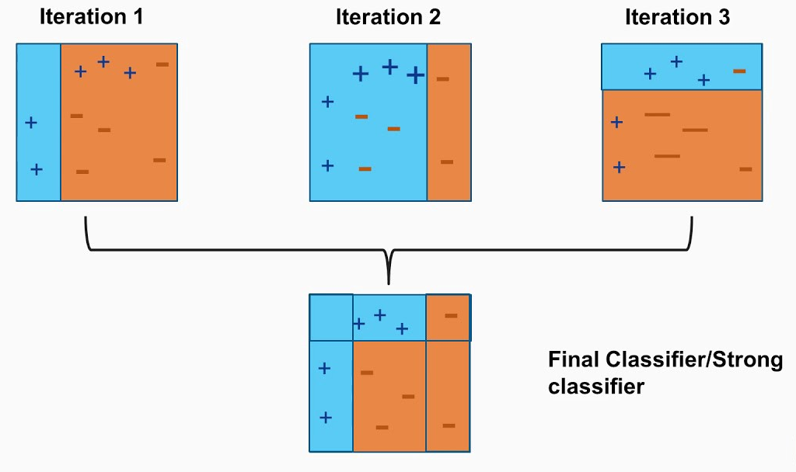
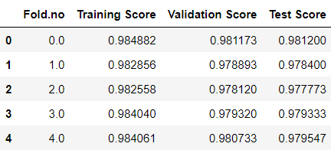
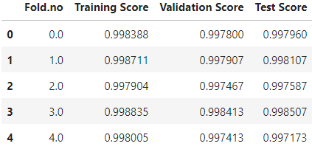
Adaboost
Attributes : 52
Recordings : 6.5L
Activities : 12
Train
Attributes : 20
Recordings : 6.5L
Activities : 12
Validation
Test
Model

Slide 10
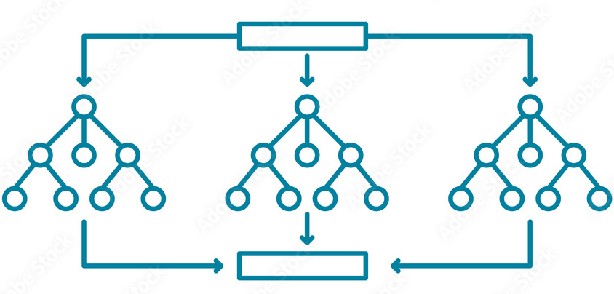
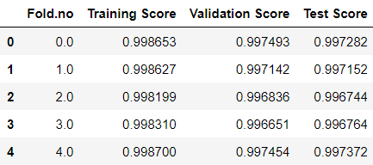
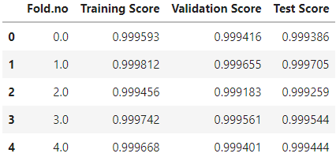
Random Forest
Attributes : 20
Recordings : 19L
Activities : 12
Attributes : 52
Recordings : 19L
Activities : 12
Train
Validation
Test
Model

Slide 11
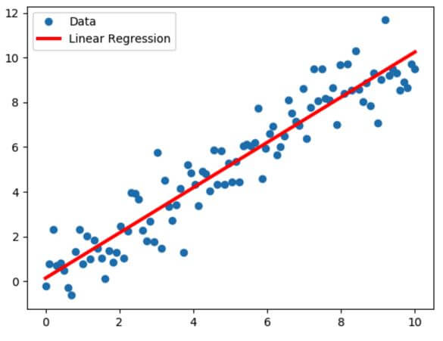
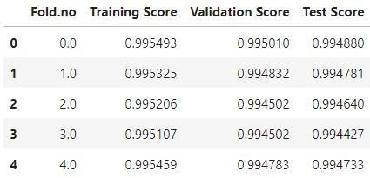
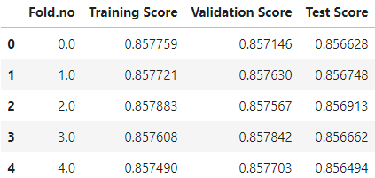
Miscellaneous
Attributes : 52
Recordings : 19L
Activities : 12
Train
Validation
Test
Model

Slide 12
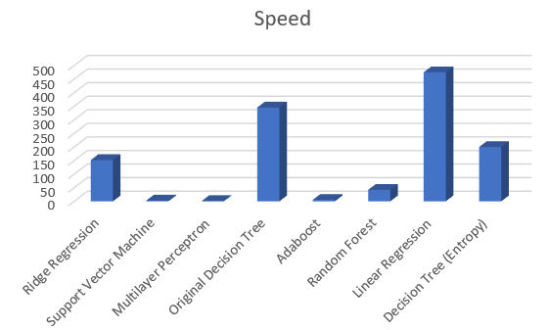
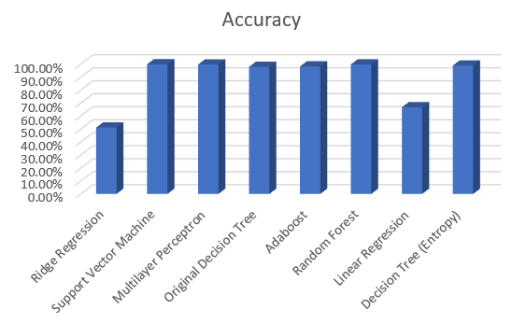
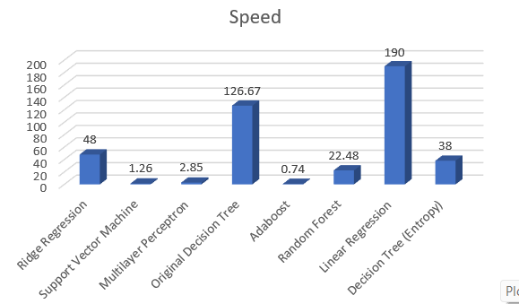
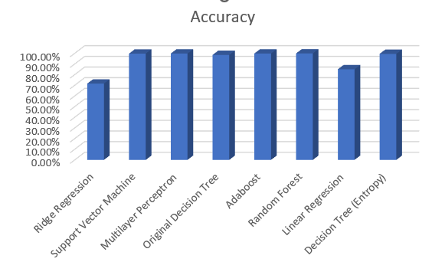
Results
Classifier | Accuracy | Training samples | Time (in minutes) | Speed
Ridge Regression | 51.1% | 19L | 12.5 | 152
Support Vector Machine | 99.8% | 6.5L | 228 | 2.8
Multilayer Perceptron | 99.6% | 6.5L | 528.5 | 1.22
Original Decision Tree | 97.8% | 19L | 5.5 | 345.5
Adaboost | 98.12% | 6.5L | 126.5 | 5.13
Random Forest | 99.7% | 19L | 45.16 | 42.07
Logistic Regression | 66.7% | 19L | 4 | 475
Decision Tree (Entropy) | 98.8% | 19L | 9.5 | 200
Classifier | Accuracy | Training samples | Time (in minutes) | Speed
Ridge Regression | 71.6% | 19L | 39.5 | 48
Support Vector Machine | 99.7% | 6.5L | 512.5 | 1.26
Multilayer Perceptron | 99.8% | 6.5L | 228 | 2.85
Original Decision Tree | 98.5% | 19L | 15 | 126.67
Adaboost | 99.8% | 6.5L | 876 | 0.74
Random Forest | 99.9% | 19L | 84.5 | 22.48
Logistic Regression | 85% | 19L | 10 | 190
Decision Tree (Entropy) | 99.5% | 19L | 50 | 38

Slide 13
Observations
Most of the classifiers misclassified ironing as standing, ascending stairs with descending stairs and Nordic walking as walking and vice versa
Logistic regression is fast compared to others but the accuracy is relatively low.
Random Forest and SVM has the best accuracy but according to speed, there are other classifiers which performed better.
Out of all the classifiers, Decision Tree with Gini criteria is found be optimal classifier with respect to accuracy and speed.
When considering a subset of attributes, all the models performed comparatively similar using complete data.
Logistic regression outperformed Ridge Regression
Accuracy of Entropy > Accuracy of Gini Impurity
Training time of ensembles is more than that of normal classifiers

Slide 14
Work Distribution
Vivek (2022701001) : implementing Adaboost and Decision tree(with Gini) algorithm and
making presentation.
Kesavaraj (2022701008) : implementing Random forest and Ridge regression algorithm and
making report.
Poorvaja (2020101096): implementing SVM and Decision tree (with entropy) regression
algorithm and making report.
Rohan Nain(2020102023): implementing Neural Network and Linear regression algorithm and
making presentation.
28

Slide 15


Slide 16


